Slide 1
Voice Recognition Services for Autonomous Driving
David Simões, Herlander Santos, Hugo Dias,
Roger Salgado, Rui Mendes
david.simões@ua.pt, herlander-j-santos@alticelabs.com, hugo-r-dias@alticelabs.com,
roger-a-salgado@alticelabs.com, ruidamendes@ua.pt
Sunset Hackathon 2017
Notes:
Good morning. My name is David, and I'm here to present the multi-agent version of the popular Double Deep Q-Networks algorithm.

Slide 2
Outline
Challenge
Architecture
Components
Demo
Results
Notes:
I will start with our motivation about our proposal, introduce some background and related work, present our algorithm and its results, and draw some conclusions.

Slide 3
Challenge
​BOSCH: Integrating Voice Recognition Services for autonomous driving or cabin interaction
Voice interaction
Occupant identification
Occupant localization
Personal Assistant
Route identification/suggestion
On-line profile integration
Cabin interaction
Radio, ACU, ...
Windows, trunk, ...
Notes:
In recent years, there have been many successes using deep representations in reinforcement learning. One of these examples is the Deep Q-Networks (or DQN) algorithm, which allowed a single agent to beat several videogames.
However, in most situations, agents interact with other agents in the system to solve a given problem.
And so, we propose to extend the DQN algorithm to the multiagent environment, and we describe two variants for cooperative scenarios, known as Independent Learners and Joint-Action Learners. We show how these variants behave in different tasks and how they can generalize to similar, but harder, tasks, with more agents or more goals to accomplish.

Slide 4
Architecture - Main Components
Central logic unit
Fetches / stores / feeds user data
Links all other units
Vehicle Control Unit
Voice recognition / localization
Voice -> Text -> Intent
Text Reply -> Speech
Voice Interaction Unit
Vehicle Display Unit
Graphical display for feedback
Entertainment system
Car sensors (temperature, speed, RPM, ...)
Car components (windows, trunk, ...)
HMI components (microphone arrays, motion detection, ...)
Sensor Control Unit
Notes:
For some context, Q-learning is a popular algorithm that determines an optimal strategy and exploits it with a greedy approach. We can prove it is optimal in single-agent scenarios, but these guarantees are lost in the multi-agent environment. It also can't handle high-complexity scenarios, and suffers from the Curse of Dimensionality.
We can solve the complexity issue through the use of deep-learning techniques, like DQN, which uses a neural network to approximate the Q-function. It keeps a separate more stable network, which is used as the optimization target, and also keeps a data-set of agent transitions to perform batch learning.

Slide 5
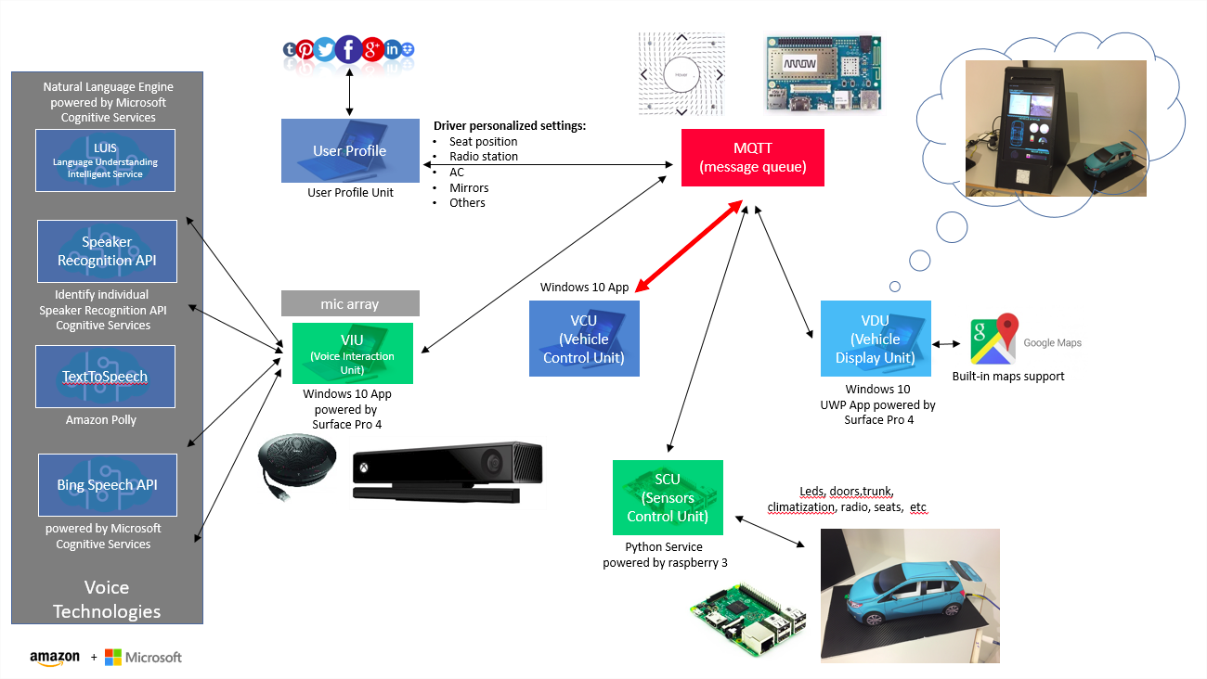
Architecture
Notes:
For some context, Q-learning is a popular algorithm that determines an optimal strategy and exploits it with a greedy approach. We can prove it is optimal in single-agent scenarios, but these guarantees are lost in the multi-agent environment. It also can't handle high-complexity scenarios, and suffers from the Curse of Dimensionality.
We can solve the complexity issue through the use of deep-learning techniques, like DQN, which uses a neural network to approximate the Q-function. It keeps a separate more stable network, which is used as the optimization target, and also keeps a data-set of agent transitions to perform batch learning.

Slide 6

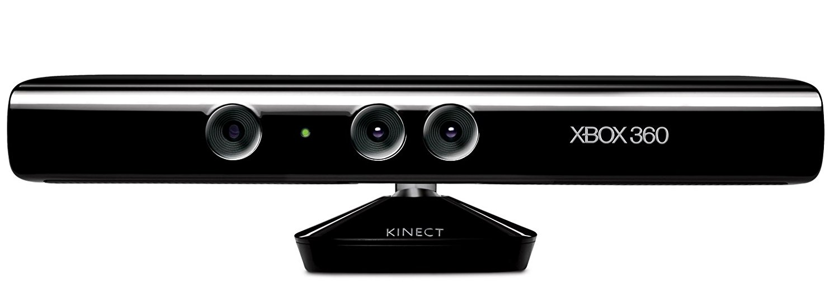
Voice Interaction Unit
Speaker Localization
Microsoft Kinect
Radial localization
Sensor Control Unit
Speaker Recognition API
Microsoft Cognitive Services
Voice recognition from pre-defined set of users
Bing Speech API
Microsoft Cognitive Services
Interpret user speech into text
LUIS
Microsoft Cognitive Services
Intent Recognition
From text into pre-defined 'intents'
Vehicle Control Unit
Text-to-Speech
Amazon Polly
Realistic human voice from pre-defined answers
Notes:
For some context, Q-learning is a popular algorithm that determines an optimal strategy and exploits it with a greedy approach. We can prove it is optimal in single-agent scenarios, but these guarantees are lost in the multi-agent environment. It also can't handle high-complexity scenarios, and suffers from the Curse of Dimensionality.
We can solve the complexity issue through the use of deep-learning techniques, like DQN, which uses a neural network to approximate the Q-function. It keeps a separate more stable network, which is used as the optimization target, and also keeps a data-set of agent transitions to perform batch learning.

Slide 7
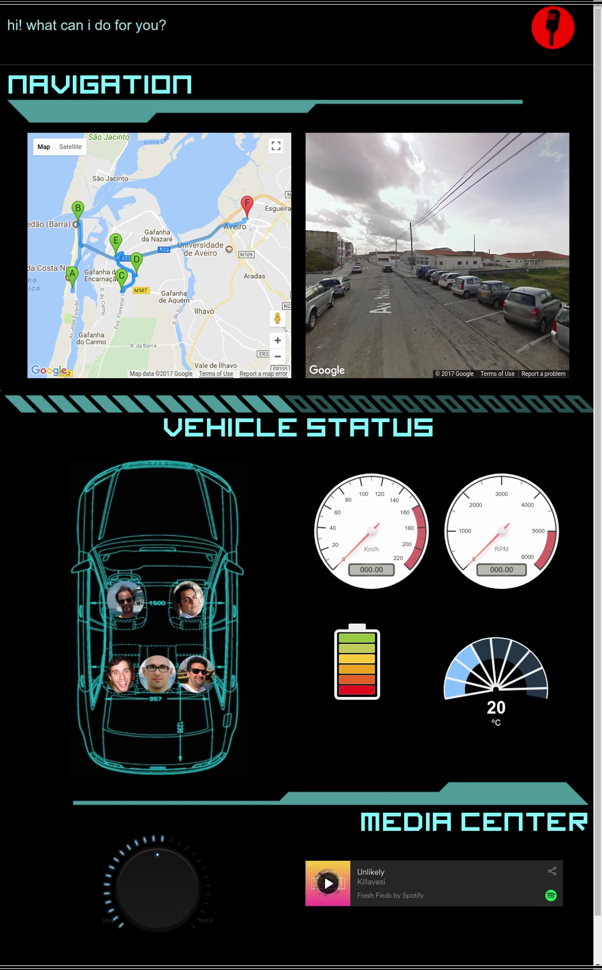
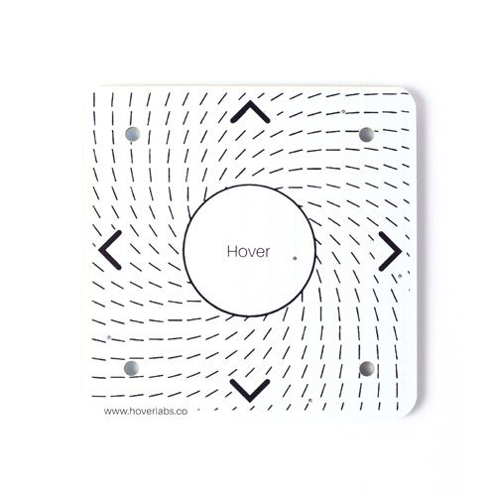
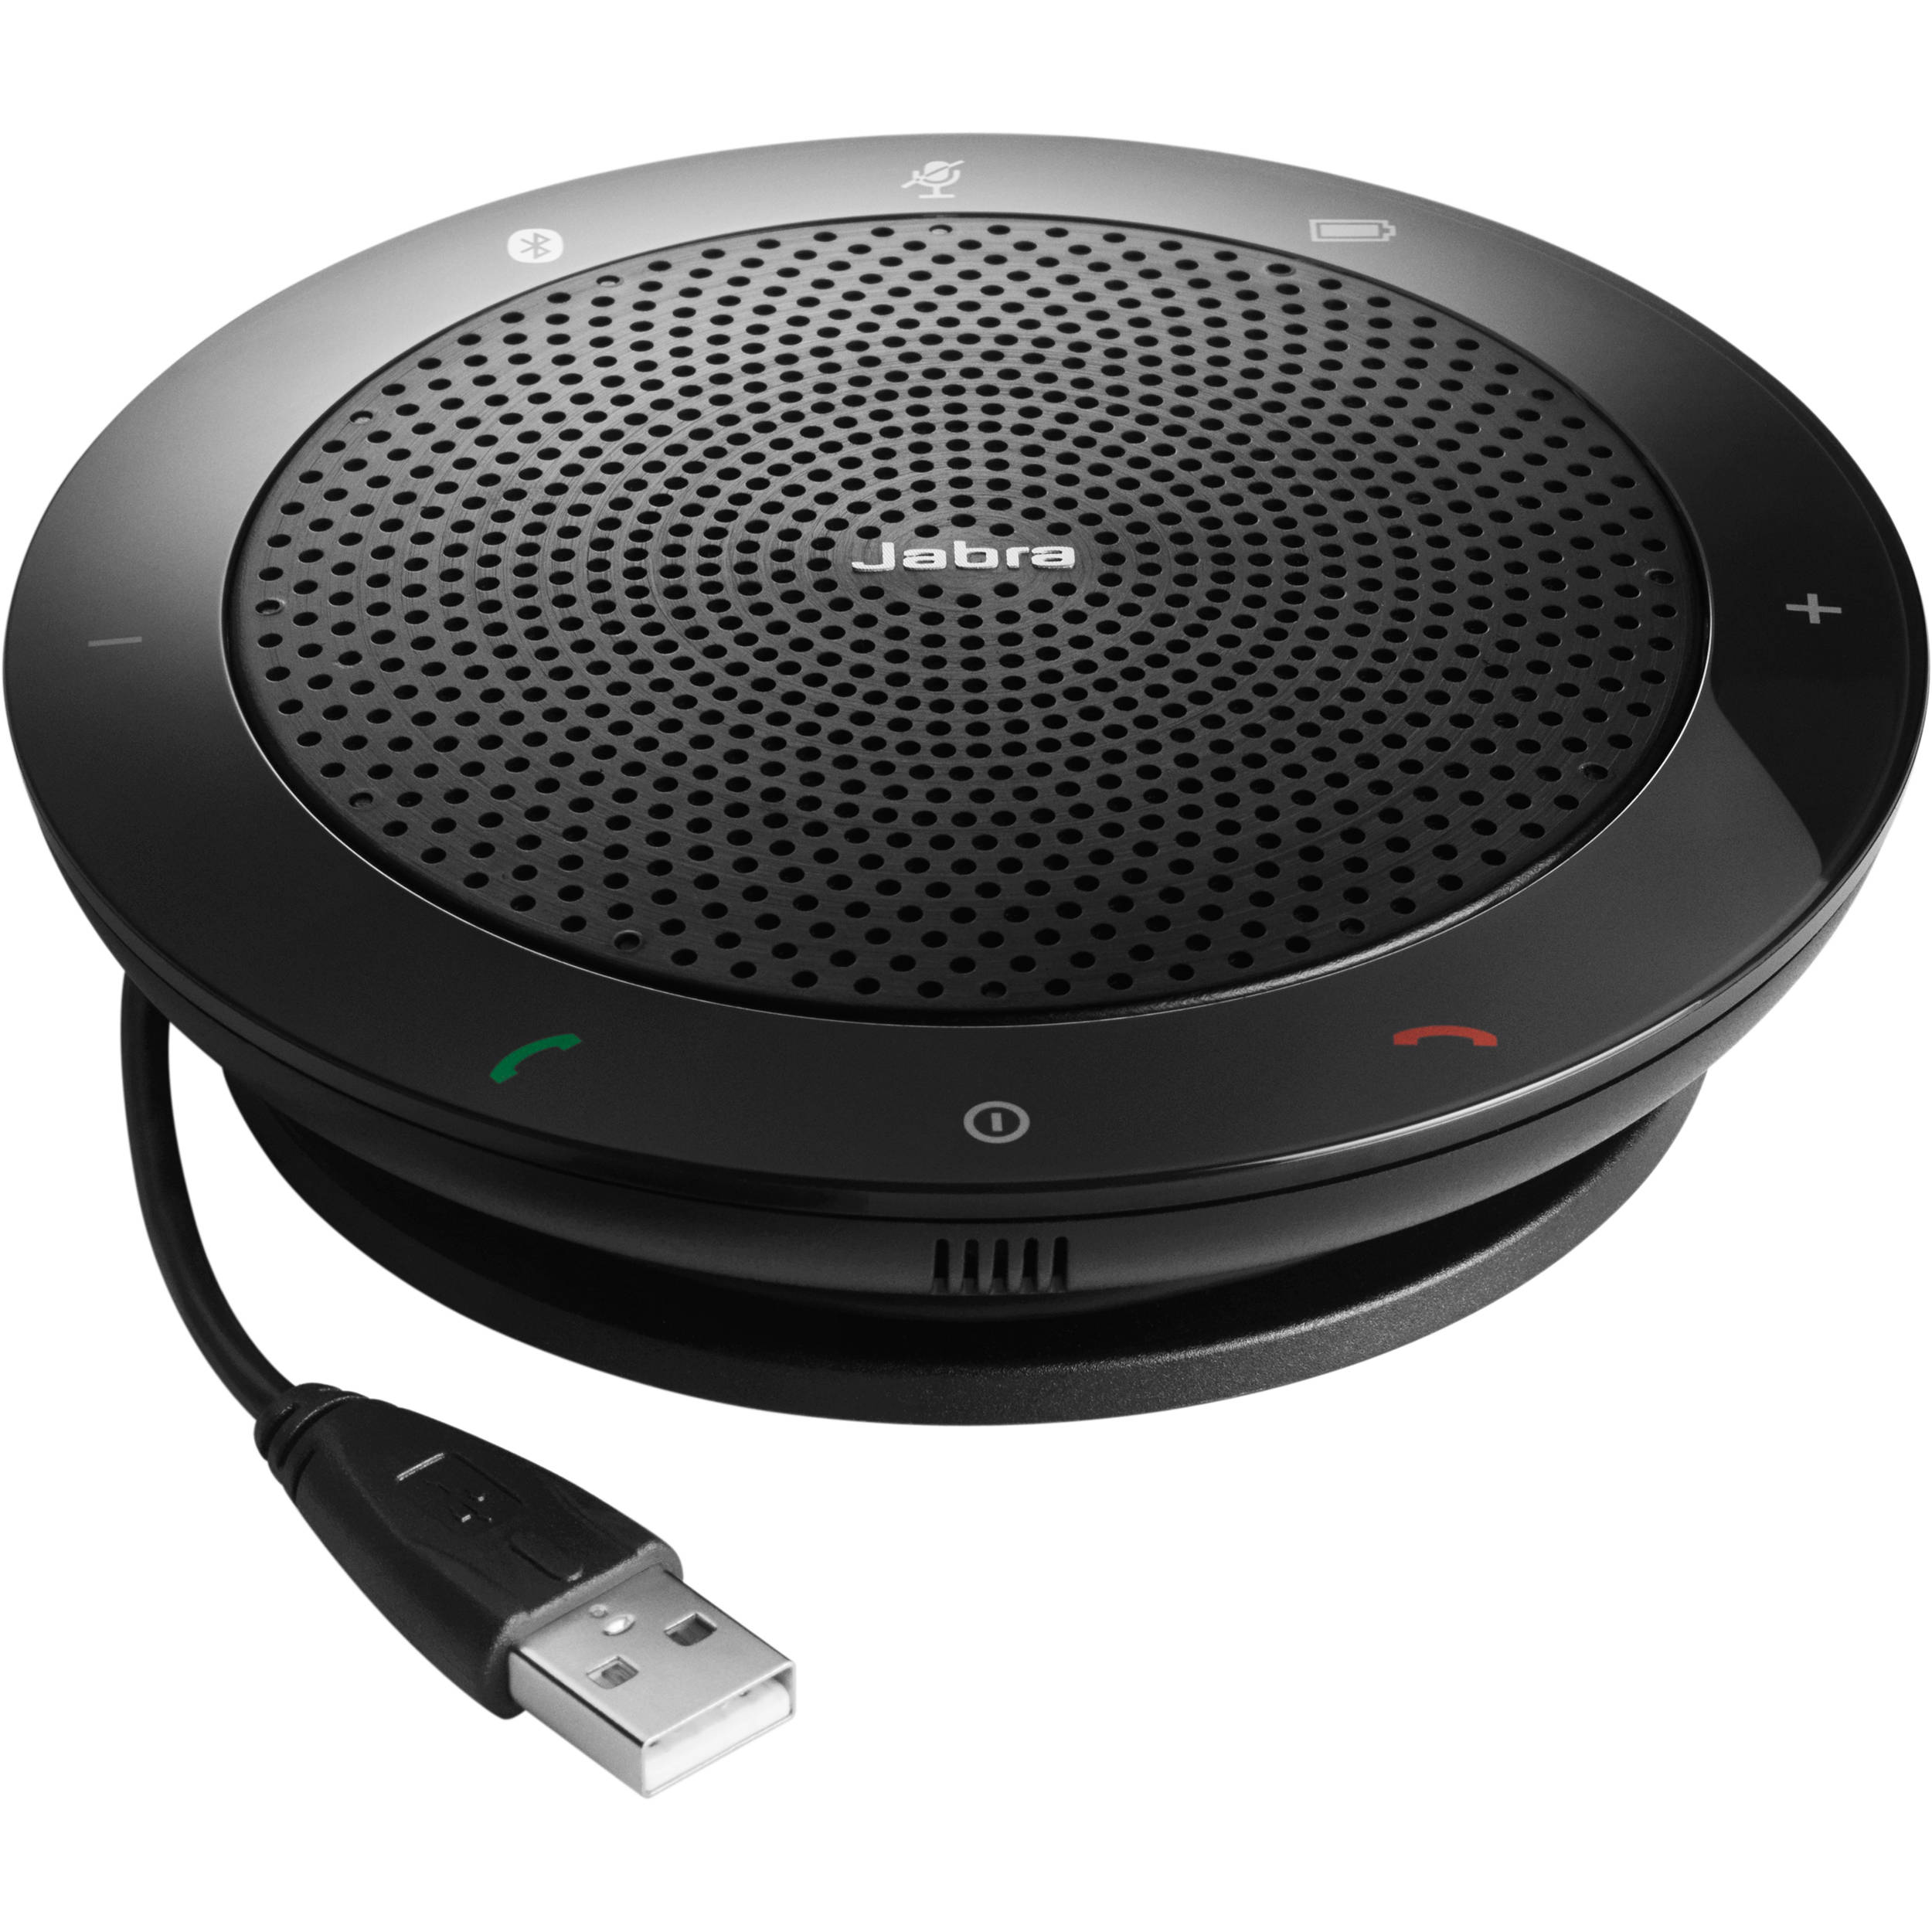
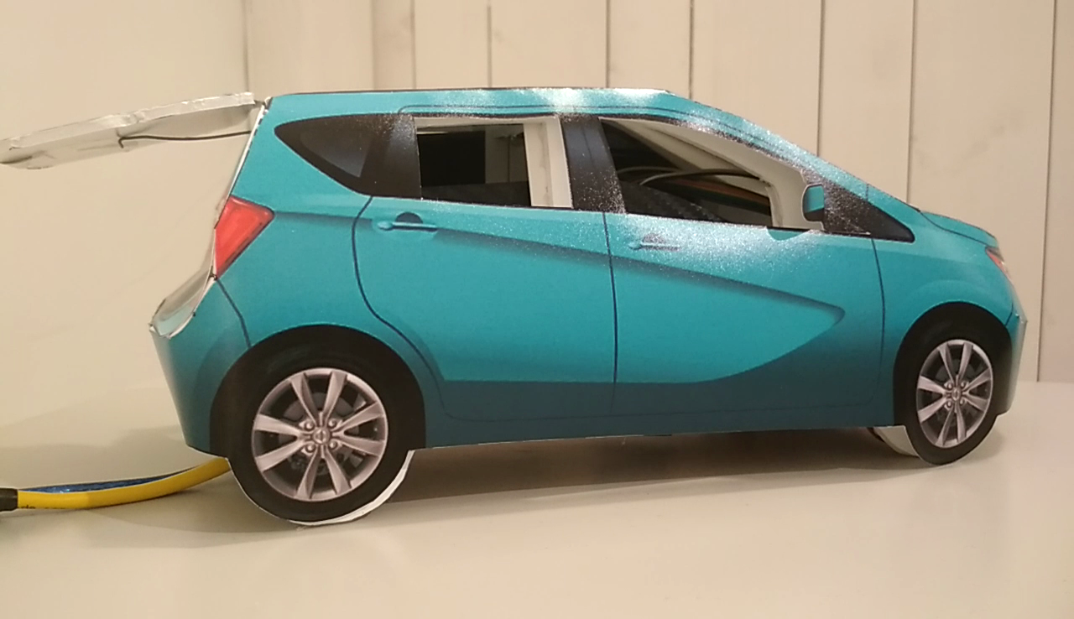
Sensor Control Unit
Temperature
Fuel/battery level
Speed
RPM
GPS
...
Car Sensors
Arduino / Virtual
Vehicle Control Unit
Voice Interaction Unit
HMI Sensors
Hover, Kinect, Jabra
Windows
Trunk
Hood
ACU
...
Car Components
Arduino / Virtual
Notes:
For some context, Q-learning is a popular algorithm that determines an optimal strategy and exploits it with a greedy approach. We can prove it is optimal in single-agent scenarios, but these guarantees are lost in the multi-agent environment. It also can't handle high-complexity scenarios, and suffers from the Curse of Dimensionality.
We can solve the complexity issue through the use of deep-learning techniques, like DQN, which uses a neural network to approximate the Q-function. It keeps a separate more stable network, which is used as the optimization target, and also keeps a data-set of agent transitions to perform batch learning.

Slide 8
Vehicle Display Unit
Car State Sensors
GPS Route
Occupant Profiles
...
Graphical Feedback
Flask / Raspberry Pi
Vehicle Control Unit
Spotify
Netflix
Facebook
Google Calendar
...
Entertainment System
On-line Services
Notes:
For some context, Q-learning is a popular algorithm that determines an optimal strategy and exploits it with a greedy approach. We can prove it is optimal in single-agent scenarios, but these guarantees are lost in the multi-agent environment. It also can't handle high-complexity scenarios, and suffers from the Curse of Dimensionality.
We can solve the complexity issue through the use of deep-learning techniques, like DQN, which uses a neural network to approximate the Q-function. It keeps a separate more stable network, which is used as the optimization target, and also keeps a data-set of agent transitions to perform batch learning.

Slide 9
Vehicle Display Unit
Car State Sensors
GPS Route
Occupant Profiles
...
Graphical Feedback
Flask / Raspberry Pi
Vehicle Control Unit
Spotify
Netflix
Facebook
Google Calendar
...
Entertainment System
On-line Services
Notes:
For some context, Q-learning is a popular algorithm that determines an optimal strategy and exploits it with a greedy approach. We can prove it is optimal in single-agent scenarios, but these guarantees are lost in the multi-agent environment. It also can't handle high-complexity scenarios, and suffers from the Curse of Dimensionality.
We can solve the complexity issue through the use of deep-learning techniques, like DQN, which uses a neural network to approximate the Q-function. It keeps a separate more stable network, which is used as the optimization target, and also keeps a data-set of agent transitions to perform batch learning.

Slide 10
Vehicle Control Unit
Voice Interaction Unit
Map intents to actions
Return appropriate responses
Vehicle Control Unit
Vehicle Display Unit
Update Sensor Information
Execute entertainment commands
Sensor Control Unit
Read user input
Read car state
Execute actions
Notes:
For some context, Q-learning is a popular algorithm that determines an optimal strategy and exploits it with a greedy approach. We can prove it is optimal in single-agent scenarios, but these guarantees are lost in the multi-agent environment. It also can't handle high-complexity scenarios, and suffers from the Curse of Dimensionality.
We can solve the complexity issue through the use of deep-learning techniques, like DQN, which uses a neural network to approximate the Q-function. It keeps a separate more stable network, which is used as the optimization target, and also keeps a data-set of agent transitions to perform batch learning.

Slide 11
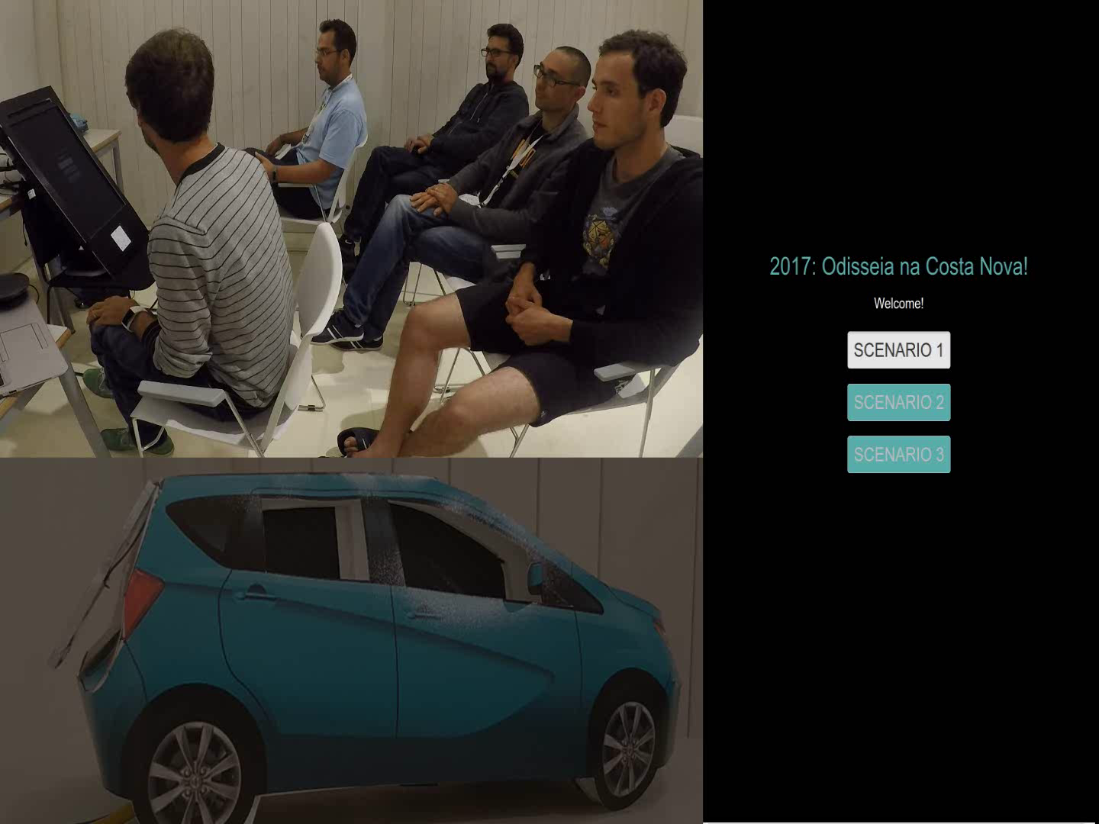
Demo
Notes:
For some context, Q-learning is a popular algorithm that determines an optimal strategy and exploits it with a greedy approach. We can prove it is optimal in single-agent scenarios, but these guarantees are lost in the multi-agent environment. It also can't handle high-complexity scenarios, and suffers from the Curse of Dimensionality.
We can solve the complexity issue through the use of deep-learning techniques, like DQN, which uses a neural network to approximate the Q-function. It keeps a separate more stable network, which is used as the optimization target, and also keeps a data-set of agent transitions to perform batch learning.

Slide 12
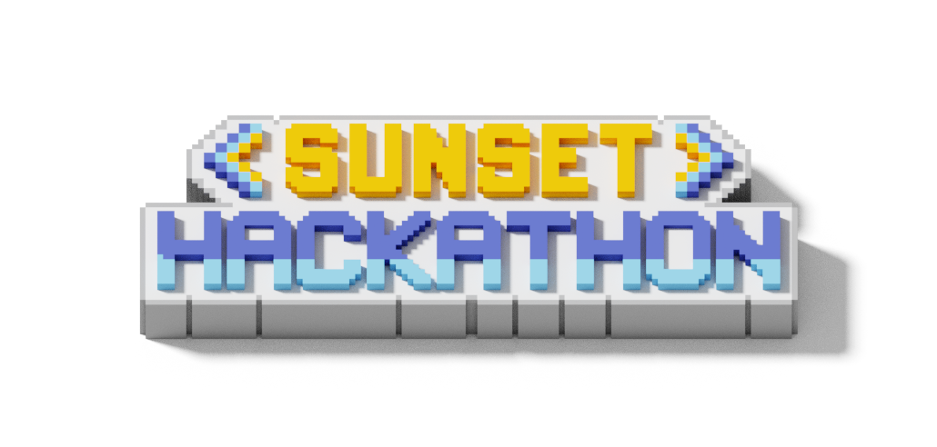
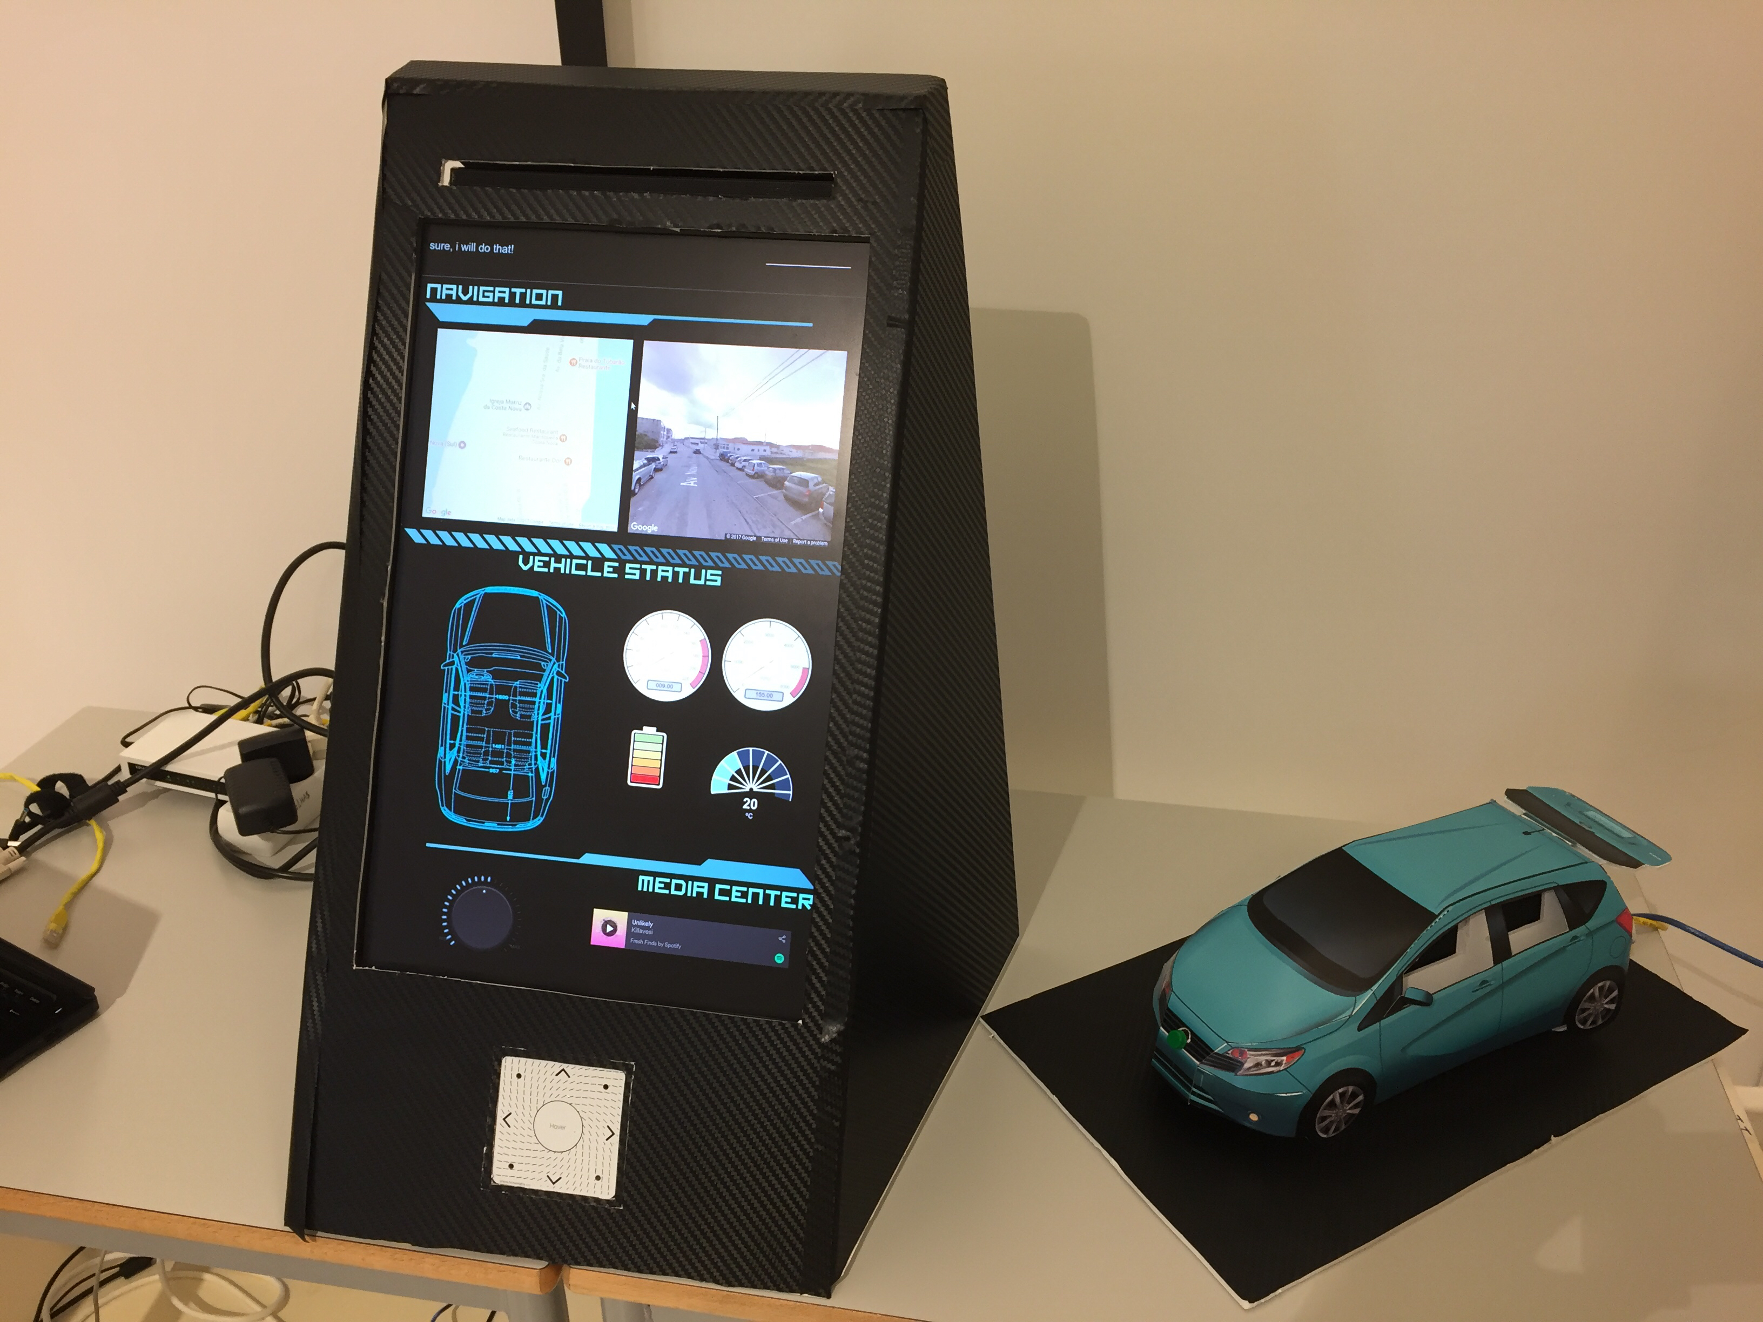
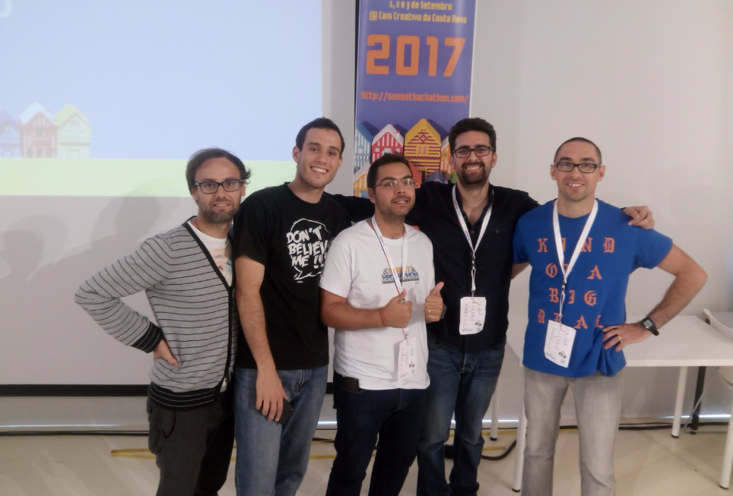
Results
1st Place in Sunset Hackathon '17
Bosch intends to continue project
Notes:
To sum up, we extended the Double DQN algorithm to the multi-agent paradigm. We used both the Independent Learners and the Joint-Action Learners techniques, and demonstrated their viability for learning complex policies in high-dimensional multi-agent scenarios.
We also showed how the algorithm can generalize to not only more complex tasks, but also to larger numbers of agents, by taking advantage of transfer learning to speed up training. We also concluded that the Joint-Action variant is harder to generalize and has more requirements than the Independent variant.
In the future, we plan on extending the algorithm to make use of other multiagent adaptations of Q-learning, other than IL and JAL, toallow for stochastic policies. We also plan to extend other deep reinforcement techniques (aside from DQN) and compare them with our proposal.

Slide 13
Voice Recognition Services for Autonomous Driving
David Simões, Herlander Santos, Hugo Dias,
Roger Salgado, Rui Mendes
david.simões@ua.pt, herlander-j-santos@alticelabs.com, hugo-r-dias@alticelabs.com,
roger-a-salgado@alticelabs.com, ruidamendes@ua.pt
Thank you!
Questions?
Notes:
Good morning. My name is David, and I'm here to present the multi-agent version of the popular Double Deep Q-Networks algorithm.

